Slide 1
Chapter 7
Digital Design and Computer Architecture, 2nd Edition
David Money Harris and Sarah L. Harris

Slide 2
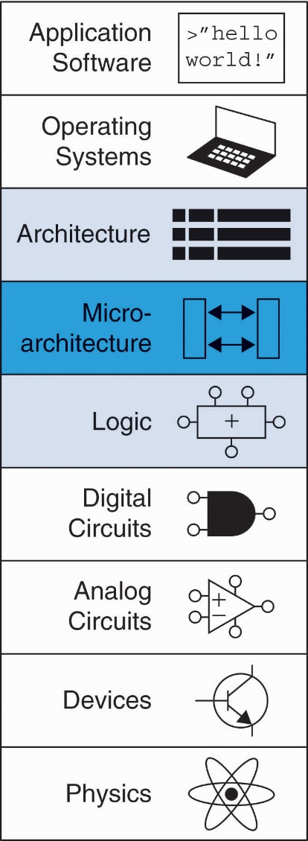
Chapter 7 :: Topics
Introduction
Performance Analysis
Single-Cycle Processor
Multicycle Processor
Pipelined Processor
Exceptions
Advanced Microarchitecture

Slide 3
Multicycle MIPS Processor
Single-cycle:
+ simple
cycle time limited by longest instruction (lw)
2 adders/ALUs & 2 memories
Multicycle:
+ higher clock speed
+ simpler instructions run faster
+ reuse expensive hardware on multiple cycles
- sequencing overhead paid many times
Same design steps: datapath & control

Slide 4
Multicycle State Elements
Replace Instruction and Data memories with a single unified memory – more realistic

Slide 5
Multicycle Datapath: Instruction Fetch
STEP 1: Fetch instruction

Slide 6
Multicycle Datapath: lw Register Read
STEP 2a: Read source operands from RF

Slide 7
Multicycle Datapath: lw Immediate
STEP 2b: Sign-extend the immediate

Slide 8
Multicycle Datapath: lw Address
STEP 3: Compute the memory address

Slide 9
Multicycle Datapath: lw Memory Read
STEP 4: Read data from memory

Slide 10
Multicycle Datapath: lw Write Register
STEP 5: Write data back to register file

Slide 11
Multicycle Datapath: Increment PC
STEP 6: Increment PC

Slide 12
Multicycle Datapath: sw
Write data in rt to memory

Slide 13
Multicycle Datapath: R-Type
Read from rs and rt
Write ALUResult to register file
Write to rd (instead of rt)

Slide 14
Multicycle Datapath: beq
rs == rt?
BTA = (sign-extended immediate << 2) + (PC+4)

Slide 15
Multicycle Processor

Slide 16
Multicycle Control

Slide 17
Main Controller FSM: Fetch

Slide 18
Main Controller FSM: Fetch

Slide 19
Main Controller FSM: Decode

Slide 20
Main Controller FSM: Address

Slide 21
Main Controller FSM: Address

Slide 22
Main Controller FSM: lw

Slide 23
Main Controller FSM: sw

Slide 24
Main Controller FSM: R-Type

Slide 25
Main Controller FSM: beq

Slide 26
Multicycle Controller FSM

Slide 27
Extended Functionality: addi

Slide 28
Main Controller FSM: addi

Slide 29
Extended Functionality: j

Slide 30
Main Controller FSM: j

Slide 31
Main Controller FSM: j

Slide 32
Multicycle Processor Performance
Instructions take different number of cycles:
3 cycles: beq, j
4 cycles: R-Type, sw, addi
5 cycles: lw
CPI is weighted average
SPECINT2000 benchmark:
25% loads
10% stores
11% branches
2% jumps
52% R-type
Average CPI = (0.11 + 0.2)(3) + (0.52 + 0.10)(4) + (0.25)(5) = 4.12

Slide 33
Multicycle Processor Performance
Multicycle critical path:
T_{c} = t_{pcq} + t_{mux} + max(t_{ALU} + t_{mux}, t_{mem}) + t_{setup}

Slide 34
Multicycle Performance Example
Element | Parameter | Delay (ps)
Register clock-to-Q | t_{pcq_PC} | 30
Register setup | t_{setup} | 20
Multiplexer | t_{mux} | 25
ALU | t_{ALU} | 200
Memory read | t_{mem} | 250
Register file read | t_{RFread} | 150
Register file setup | t_{RFsetup} | 20
T_{c} = ?

Slide 35
Multicycle Performance Example
Element | Parameter | Delay (ps)
Register clock-to-Q | t_{pcq_PC} | 30
Register setup | t_{setup} | 20
Multiplexer | t_{mux} | 25
ALU | t_{ALU} | 200
Memory read | t_{mem} | 250
Register file read | t_{RFread} | 150
Register file setup | t_{RFsetup} | 20
T_{c} = t_{pcq_PC} + t_{mux} + max(t_{ALU} + t_{mux}, t_{mem}) + t_{setup}
= t_{pcq_PC} + t_{mux} + t_{mem} + t_{setup}
= [30 + 25 + 250 + 20] ps
= 325 ps

Slide 36
Chapter 7 :: Topics
For a program with 100 billion instructions executing on a multicycle MIPS processor
CPI = 4.12
T_{c} = 325 ps
Execution Time =

Slide 37
For a program with 100 billion instructions executing on a multicycle MIPS processor
CPI = 4.12
T_{c} = 325 ps
Execution Time = (# instructions) × CPI × T_{c}
= (100 × 10⁹)(4.12)(325 × 10⁻¹²)
= 133.9 seconds
This is slower than the single-cycle processor (92.5 seconds). Why?

Slide 38
Multicycle Performance Example
Program with 100 billion instructions
Execution Time = (# instructions) × CPI × T_{c}
= (100 × 10⁹)(4.12)(325 × 10⁻¹²)
= 133.9 seconds
This is slower than the single-cycle processor (92.5 seconds). Why?
Not all steps same length
Sequencing overhead for each step (t_{pcq} + t_{setup}= 50 ps)

Slide 39
Review: Single-Cycle Processor

Slide 40
Review: Multicycle Processor

